Slide 1

JAVA

Slide 2

What is Java?
General-purpose, class-based, object-oriented programming language

Slide 3
Features of Java
Simple
Object-Oriented
Portable
Platform independent
Robust
Architecture neutral
High Performance
Multithreaded
Distributed

Slide 4
Types of Java Applications
1) Standalone Application
2) Web Application
3) Enterprise Application
4) Mobile Application

Slide 5
Desktop GUI Applications
We use APIs like AWT, Swing, JavaFX to build these applications.
Examples of desktop GUI applications are Acrobat Reader,Media Player, Antiviruses, etc.

Slide 6
Web-based Applications
Java support for web development through Servlet, JSP, and Struts.
Also known as a server-side programming language.
frameworks Spring, Hibernate, Spring Boot, used for developing web-based applications.
LinkedIn, AliExpress, web.archive.org, IRCTC, etc. are the popular websites that are written using Java programming language.

Slide 7
Enterprise Applications of Java
Java EE (Java Enterprise Edition) is used to provide the tools to develop large-scale,scalable, reliable, distributed and secured network applications in enterprises.
JavaEE is considered as the backbone for a variety of banking applications
Companies like Naukri, Jabong, Google, Myntra, Flipkart, Trivago, ibibo, TCS, Infosys, HCL, Wipro, Pinterest, eBay, etc use Java.

Slide 8
Mobile Applications
Most of the android applications build using Java.
Popular android app development IDE Android Studio also uses Java for developing android applications.
The most popular android applications Spotify and Twitter are developed using Java

Slide 9
Gaming Applications
Android games can be built with Java.
Java supports jMonkeyEngine which is the most powerful open-source 3D-Engine and has the capacity to design 3-Dimensional games.
some popular Frameworks and Libraries available for Game Development, like - LibGDX and OpenGL.
games developed in Java are Minecraft, Mission Impossible III, etc

Slide 10
Java Platforms / Editions
1) Java SE (Java Standard Edition)
2) Java EE (Java Enterprise Edition)
3) Java ME (Java Micro Edition)
4) JavaFX

Slide 11
Java Platform, Standard Edition (Java SE):
Java SE’s API offers the Java programming language’s core functionality.
Defines all the basis of type and object to high-level classes.
Used for networking, security, database access, graphical user interface (GUI) development.

Slide 12
Java Platform, Enterprise Edition (Java EE):
Offers an API and runtime environment for developing and running highly scalable, large-scale, and secure network applications.
Java Programming Language Platform, Micro Edition (Java ME):
Offers an API and a small-footprint virtual machine running Java programming language applications on small devices, like mobile phones.

Slide 13
Java FX:
Platform for developing rich internet applications using a lightweight user-interface API.

Slide 14
Simple Java Program
class Simple
{
public static void main(String args[])
{
System.out.println("Hello Java");
}
}
To compile: | javac Simple.java
To execute: | java Simple

Slide 15
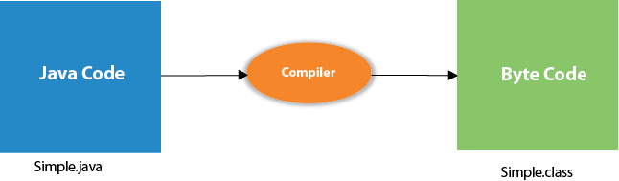
Compilation Flow

Slide 16
Valid java main method signature
public static void main(String[] args)
public static void main(String []args)
public static void main(String args[])
public static void main(String... args)
static public void main(String[] args)
public static final void main(String[] args)
final public static void main(String[] args)

Slide 17
Invalid java main method signature
public void main(String[] args)
static void main(String[] args)
public void static main(String[] args)
abstract public static void main(String[] args)

Slide 18
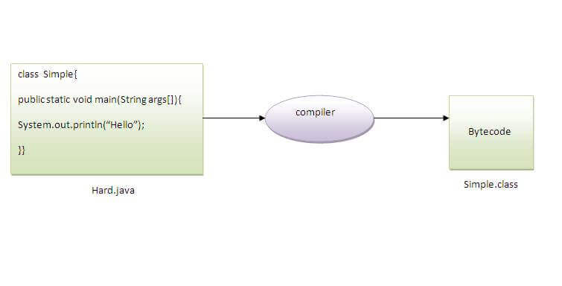
Can you save a java source file by other name than the class name?
To compile: | javac Simple.java
To execute: | java Simple

Slide 19
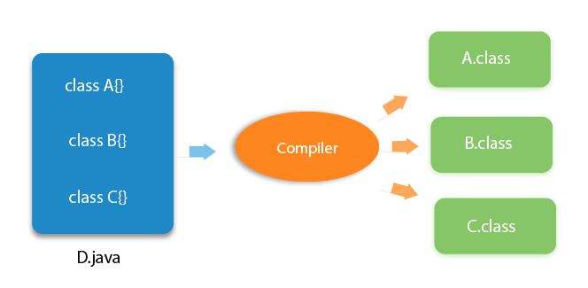
Can you have multiple classes in a java source file?

Slide 20
Java Variables

Slide 21
Java Variables
Variable is a name of memory location.
Is a combination of "vary + able" that means its value can be changed.
There are three types of variables in java:
local variable
instance variable
static variable

Slide 22
Local Variable:
Variable declared inside the body of the method.
We can use this variable only within that method
Cannot be defined with "static" keyword
2. Instance Variable
Variable declared inside the class but outside the body of the method.
It is not declared as static.
3. Static variable
Variable which is declared as static is called static variable.
It cannot be local
Memory allocation for static variable happens only once when the class is loaded in the memory

Slide 23
Example to understand the types of variables in java
class A
{
int data=50; //instance variable
static int m=100; //static variable
void method()
{
int n=90; //local variable
}
}

Slide 24
Java Variable Example: Widening
class Simple{
public static void main(String[] args)
{
int a=10;
float f=a;
System.out.println(a);
System.out.println(f);
}}
OUTPUT:
10
10.0

Slide 25
Java Variable Example: Narrowing
class Simple {
public static void main(String[] args) {
float f=10.5f;
int a=f;
int a=(int)f;
System.out.println(f);
System.out.println(a);
}}
OUTPUT:
10.5
10

Slide 26
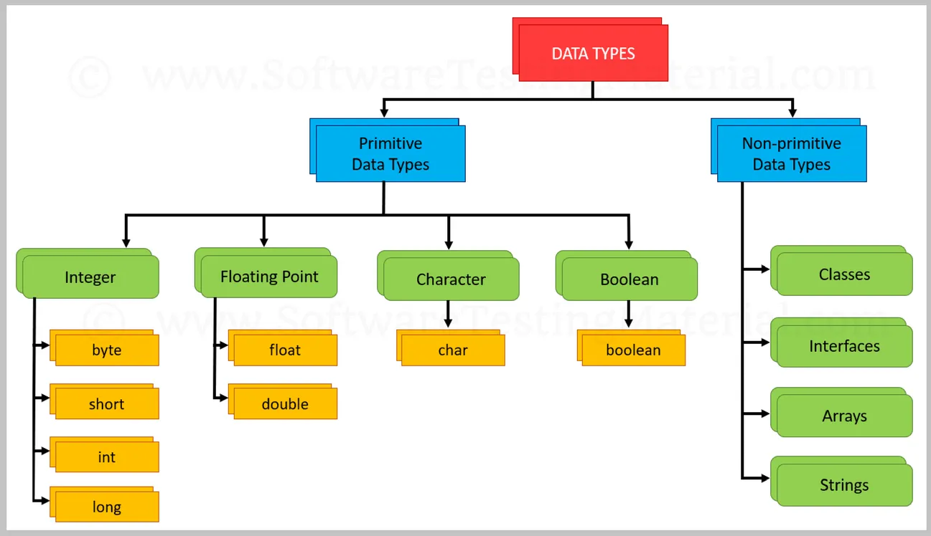
Data Types in Java

Slide 27
Integer
This group includes byte, short, int, long
byte :
It is 1 byte(8-bits) integer data type.
Value range from -128 to 127.
Default value zero.
example: byte b=10;
short :
It is 2 bytes(16-bits) integer data type.
Value range from -32768 to 32767.
Default value zero.
example: short s=11;

Slide 28
int :
It is 4 bytes(32-bits) integer data type.
Value range from -2147483648 to 2147483647.
Default value zero.
example: int i=10;
long :
It is 8 bytes(64-bits) integer data type.
Value range from -9,223,372,036,854,775,808 to 9,223,372,036,854,775,807.
Default value zero. example:
long l=100012;

Slide 29
// byte type
byte b = 20;
System.out.println("b= "+b);
// short type
short s = 20;
System.out.println("s= "+s);
// int type
int i = 20;
System.out.println("i= "+i);
// long type
long l = 20;
System.out.println("l= "+l);

Slide 30
Floating-Point Number
This group includes float, double
float :
It is 4 bytes(32-bits) float data type.
Default value 0.0f.
example: float ff=10.3f;
double :
It is 8 bytes(64-bits) float data type.
Default value 0.0d.
example: double db=11.123;

Slide 31
Characters
Data types used to store characters are char.
Uses unicode to represent characters.
Unicode defines a fully international character set that can represent all of the characters found in all human languages like, latin, greek, arabic, and many more.
This data type is a single 16-bit(2bytes) unicode character and its value-ranges between ‘\u0000’ (or 0) to ‘\uffff’ (or 65,535 inclusive).

Slide 32
The \u in your example is for Unicode, we can store unicode characters that take up to 16 bits, from \u0000 to \uFFFF.

Slide 33
public class Demo {
public static void main(String[] args)
{
char ch = 'S';
System.out.println(ch);
char ch2 = '&';
System.out.println(ch2);
char ch3 = '$';
System.out.println(ch3);
} }
Output:
S
&
$

Slide 34
Boolean
Is used to store two possible values i.e. true or false.
Default value is false.
Basically used for simple flags that track true/false conditions.

Slide 35
public class Demo {
public static void main(String[] args) {
boolean t = true;
System.out.println(t);
boolean f = false;
System.out.println(f);
} }

Slide 36
Type casting in java

Slide 37
Type Casting in Java
Process of converting the value of one data type (int, float, double, etc.) Into another data type is known as type casting.

Slide 38
There are two types of casting:
Widening Casting (automatically) - converting a smaller type to a larger type size
byte -> short -> char -> int -> long -> float -> double
Narrowing Casting (manually) - converting a larger type to a smaller size type
double -> float -> long -> int -> char -> short -> byte

Slide 39
Widening Casting
public class Test
{
public static void main(String[] args)
{
int i = 100;
long l = i;
float f = l;
System.out.println("Int value "+i);
System.out.println("Long value "+l);
System.out.println("Float value "+f);
}
}
Output:
Int value 100
Long value 100
Float value 100.0

Slide 40
Narrowing Casting
public class Test
{
public static void main(String[] args)
{
double d = 100.04;
long l = (long)d; //explicit type casting required
int i = (int)l; //explicit type casting required
System.out.println("Double value "+d);
System.out.println("Long value "+l);
System.out.println("Int value "+i);
} }
Output:
Double value 100.04
Long value 100
Int value 100

Slide 41
Example 2:
byte b;
int i = 257;
double d = 323.142;
System.out.println("Conversion of int to byte.");
// i % 256
b = (byte)i;
System.out.println("i = " + i + " b = " + b);
System.out.println(
// d % 256
b = (byte)d;
System.out.println("d = " + d + " b= " + b);

Slide 42
Output
Conversion of int to byte.
i = 257 b = 1
Conversion of double to byte.
d = 323.142 b= 67

Slide 43
Java int to char
public class IntToCharExample1{
public static void main(String args[])
{
int a=65;
char c=(char)a;
System.out.println(a);
}}
Output:
A

Slide 44
Convert char to int
char a = '5';
char b = 'c';
// convert char variables to int // ASCII value of characters is assigned
int num1 = a;
int num2 = b;
System.out.println(num1); // 53
System.out.println(num2); // 99

Slide 45
char to int using getNumericValue() method
char a = '5';
char b = '9';
// convert char variables to int // Use getNumericValue()
int num1 = Character.getNumericValue(a);
int num2 = Character.getNumericValue(b);
System.out.println(num1); // 5
System.out.println(num2); // 9

Slide 46
char to int using parseInt() method
char a = '5';
char b = '9';
// Use parseInt()
int num1 = Integer.parseInt(String.valueOf(a));
int num2 = Integer.parseInt(String.valueOf(b));
System.out.println(num1); // 5
System.out.println(num2); // 9

Slide 47
Tokens

Slide 48
Tokens
Token as the smallest individual element.
For example, we cannot create a sentence without using words;
Similarly, we cannot create a program without using tokens.
Tokens is the building block or the basic component for creating a program.

Slide 49
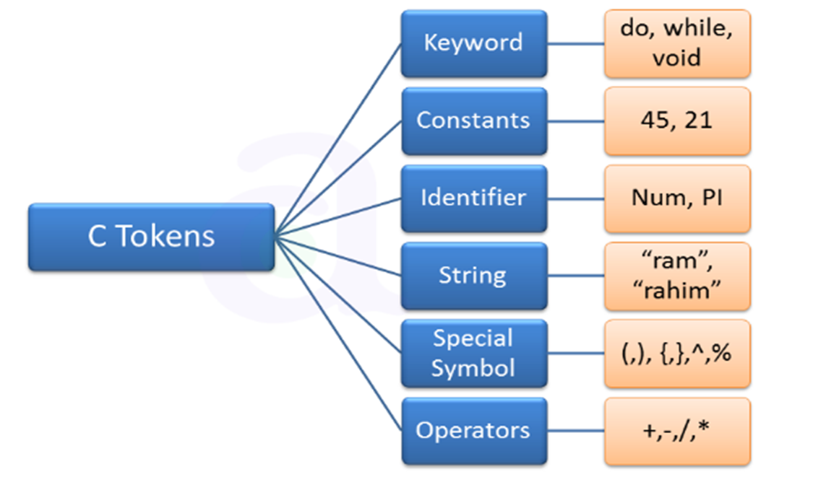

Slide 50
Keywords in Java

Slide 51
keywords
keyword is a reserved word.
We cannot use it as a variable name, constant name, etc.

Slide 52
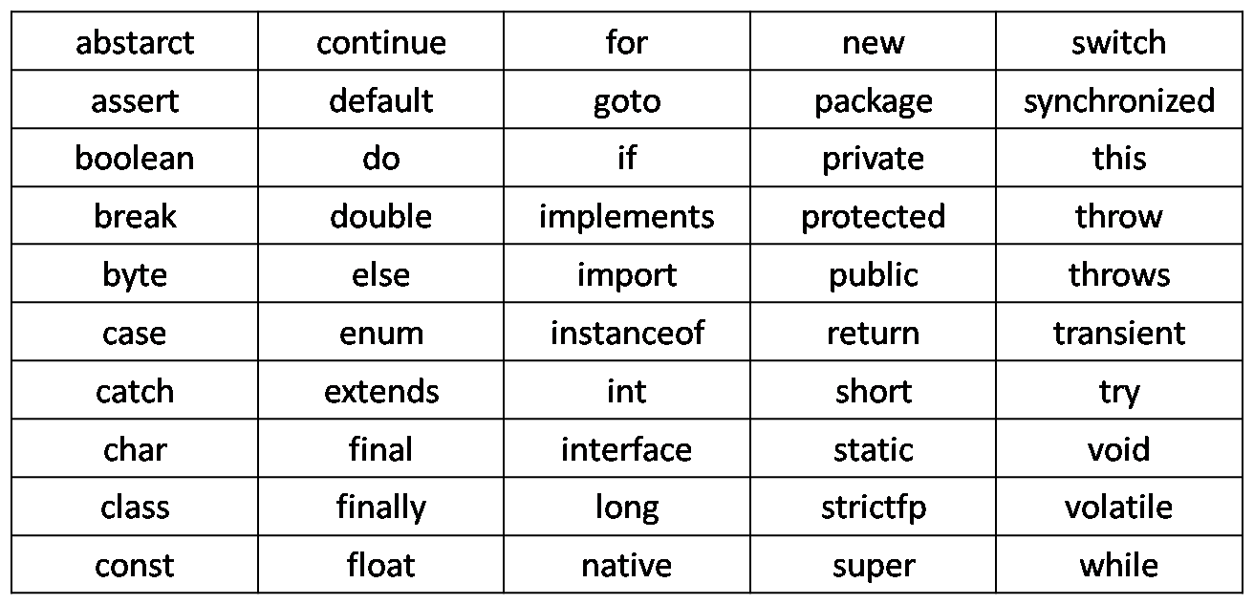

Slide 53
Identifiers

Slide 54
Identifiers
All Java variables must be identified with unique names.
These unique names are called identifiers.
Identifiers can be short names (like x and y) or more descriptive names (age, sum, totalVolume).
Note: It is recommended to use descriptive names in order to create understandable and maintainable code:

Slide 55
The general rules for naming variables are:
Names can contain letters, digits, underscores, and dollar signs
Names must begin with a letter
Names should start with a lowercase letter and it cannot contain whitespace
Names can also begin with $ and _ (but we will not use it in this tutorial)
Names are case sensitive ("myVar" and "myvar" are different variables)
Reserved words (like Java keywords, such as int or boolean) cannot be used as names

Slide 56
valid identifiers in Java:
TestVariable
testvariable
a
i
Test_Variable
_testvariable
$testvariable
sum_of_array
TESTVARIABLE
jtp123

Slide 57
Invalid identifiers
Test Variable ( We can not include a space in an identifier)
123java ( The identifier should not begin with numbers)
java+J2EE ( The plus (+) symbol cannot be used)
a-java ( Hyphen symbol is not allowed)
java_&_J2EE ( ampersand symbol is not allowed)
Java’J2EE (we can not use an apostrophe symbol in an identifier)

Slide 58
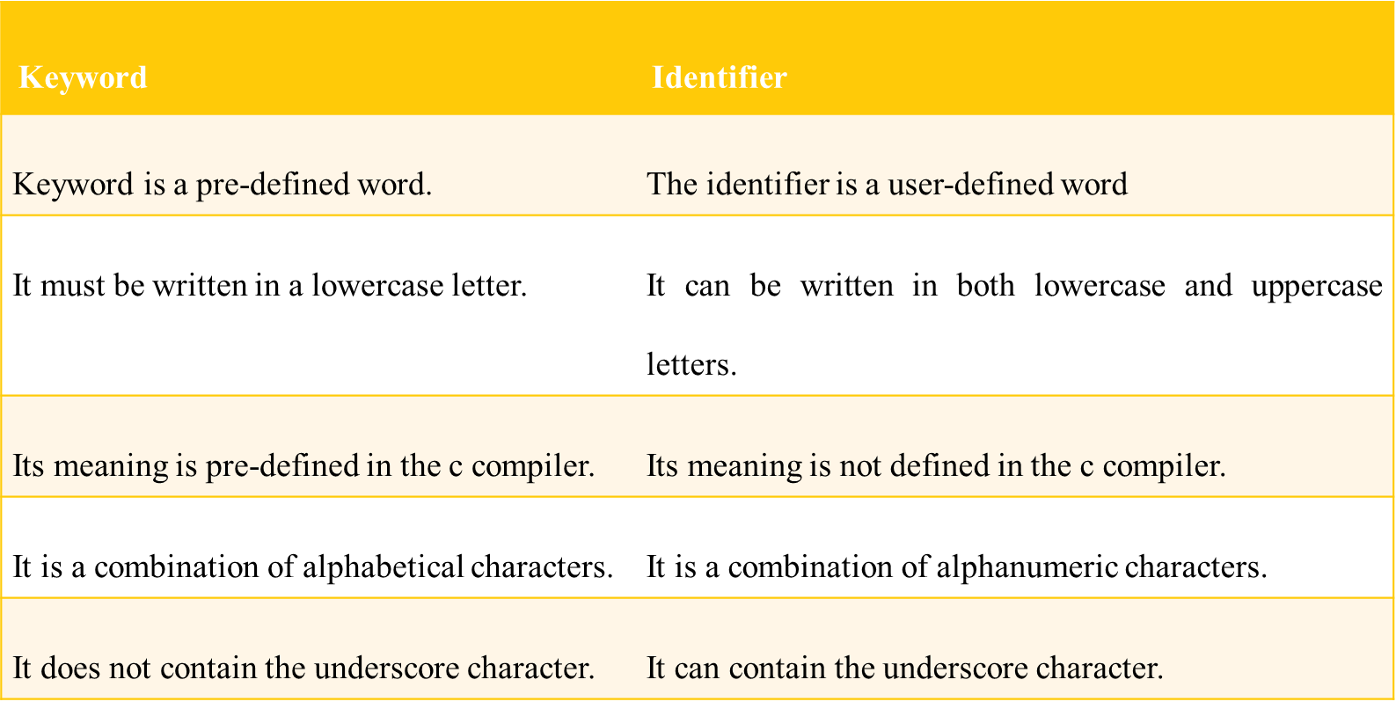
Difference Between Keyword and Identifier

Slide 59
Literals in java

Slide 60
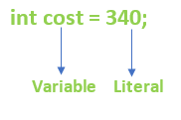
What are Literals in Java?
Have a constant value and a fixed data type and are often known as constants in Java.
Literals are assigned to a variable to provide a value to the variable.
Example: int cost =340 ;

Slide 61
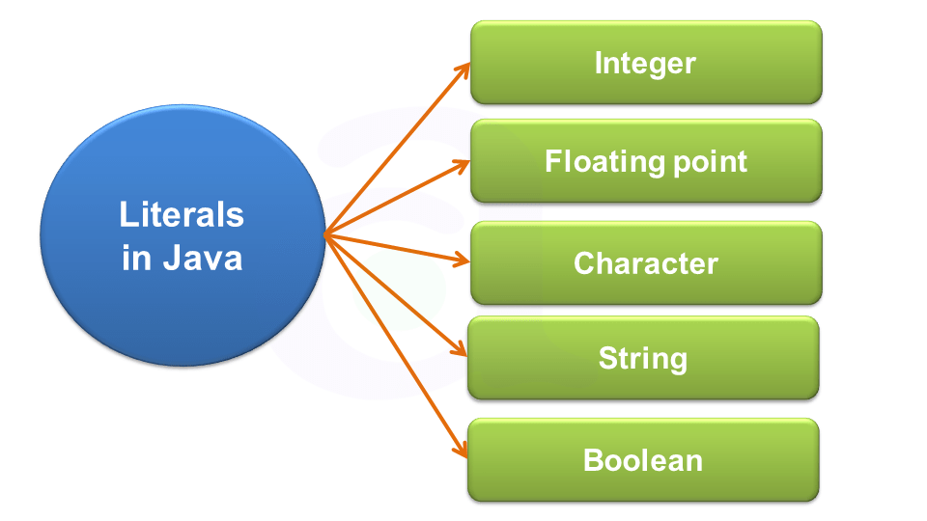
Types of Literals in Java

Slide 62
Integer Literals
Integer literals are sequences of digits.
4 types of integer literals in Java:
binary (base 2)
decimal (base 10)
octal (base 8)
hexadecimal (base 16)

Slide 63
Decimal Integer:
Integers having a base value of 10.
Contains values between 0 to 9.
Can be a positive value(+) or a negative value(-) but it cannot contain any point in between them.
Example: 1000, 1234, +78, -82, etc.

Slide 64
Octal Integer
Integers having a base value of 8
Contains values between 0 to 7.
All octal numbers must start with a 0.
Example: 012, 077,075, etc.
int octal_int=077;

Slide 65
Hexadecimal Integer:
Integers having a base value of 16.
Containing values between 0 to 15.
Contains both digits as well as characters.
Digits range from 0 to 9 and the numbers 10 to 15 are replaced by characters a to f.
Any integer starting with 0x or 0X is considered to be a hexadecimal integer.
Example: 0xff, 0x2a, 0xf1f2, etc.
int hexadec_int=0x1ff2;

Slide 66
Binary Integer
Integers with a base value of 2.
Contains only two digits 0 and 1.
Start with a 0b indicating that it is a binary digit.
Example: 0b100101, 0b1010101, etc.
int binary_int=0b1010101;

Slide 67
Example
int decimal_int=1234;
int octal_int=077;
int hexadec_int=0x1ff2;
int binary_int=0b1010101;
System.out.println("This is a Decimal Literal: "+decimal_int);
System.out.println("This is an Octal Literal: "+octal_int);
System.out.println("This is a Hexa Decimal Literal: "+hexadec_int);
System.out.println("This is a Binary Literal: "+binary_int);

Slide 68
Output
This is a Decimal Literal: 1234
This is an Octal Literal: 63
This is a Hexa Decimal Literal: 8178
This is a Binary Literal: 85

Slide 69
Floating Point Literal
Floating-point literals are values that contain a decimal point in between them.
Floating-point literals are generally double data type by default.
We can assign them to float data types by adding an f at the end of the value.
Example: float val_float=1.7732f;

Slide 70
Few points to remember while declaring floating-point literals are:
If no suffix is present, the default data type is double.
F or f suffix represents a floating data type.
D or d suffix represents a double data type.

Slide 71
Few legal and illegal floating literals:
123.45 //Legal
122.32E5 //Legal
231.12F //Legal
1/4 // Illegal Symbol Used “/”
1.7.5 //Illegal, as two decimal points used.
1,234.56 // Illegal, as commas are not allowed
123.E4 //Illegal, as E cannot precede the point.
321E //Illegal, as the exponent part is incomplete.

Slide 72
Example
float val_float=1.7732f;
double val_double=1.7732d;
float val_exponent=123E4f;
System.out.println("This is a Floating Point Literal"+val_float);
System.out.println("This is a Decimal Literal"+val_double);
System.out.println("This is an Exponential Literal"+val_exponent);

Slide 73
Output
This is a Floating Point Literal 1.7732
This is a Decimal Literal 1.7732
This is an Exponential Literal 1230000.0

Slide 74
Boolean Literal:
Contains only two values true and false.
Declared using the keyword boolean.
It is a very useful literal to declare flag variables in different programs to terminate a looping sequence.

Slide 75
Example
boolean flag1=true;
boolean flag2=false;
System.out.println("This is a boolean true flag variable "+flag1);
System.out.println("This is a boolean false flag variable "+flag2);

Slide 76
String Literal
String is basically an array of characters.
Anything written inside a double quote is a string “”.
Example
String Company = “Atria”; //Valid String Literal
String Company = Atria; //Invalid as there is no double quote.

Slide 77
Example
String company=“Atria”;
String null_Literal=null;
System.out.println("This is a String Literal: "+company);
System.out.println("This is a null Literal: "+null_Literal);
Output:
This is a String Literal: Atria
This is a null Literal: null

Slide 78
Character Literal
Character Literals in java are represented with a single quote.
Example: char ch = 'a';

Slide 79
Char literal as Integral literal:
we can specify char literal as integral literal, which represents the Unicode value of the character, and that integral literal can be specified either in Decimal, Octal, and Hexadecimal forms.
But the allowed range is 0 to 65535.
char ch = 062;

Slide 80
Unicode Representation:
We can specify char literals in Unicode representation ‘\uxxxx’.
Here xxxx represents 4 hexadecimal numbers.
char ch = '\u0061’; // Here /u0061 represent a.

Slide 81
A single character (b, t, n, f, r)
An octal number between 000 and 377
A u followed by four hexadecimal digits specifying a Unicode character

Slide 82
Example
char ch = 'a';
// It is an Integer literal with octal form
char b = 0789;
// Unicode representation
char c = '\u0061';
System.out.println(ch);
System.out.println(b);
System.out.println(c);

Slide 83
Output
a
error:Integer number too large
a

Slide 84
Operators in java

Slide 85
Operators in java
Operator in java is a symbol that is used to perform operations

Slide 86
Java Operator
Operator Type | Category | Precedence
Unary | postfix | expr++ expr--
 | prefix | ++expr --expr +expr -expr ~ !
Arithmetic | multiplicative | * / %
 | additive | + -
Shift | shift | << >>
Relational | comparison | < > <= >= instanceof
 | equality | == !=
Bitwise | bitwise AND | &
 | bitwise exclusive OR | ^
 | bitwise inclusive OR | |
Logical | logical AND | &&
 | logical OR | ||
Ternary | ternary | ? :
Assignment | assignment | = += -= *= /= %=

Slide 87
Java Unary Operator
class OperatorExample{
public static void main(String args[]){
int x=10;
System.out.println(x++);
System.out.println(++x);
System.out.println(x--);
System.out.println(--x);
}}
10
12
12
10

Slide 88
Shift Operator

Slide 89
Shift Operator
Left Shift (<<)
Right Shift (>>)

Slide 90
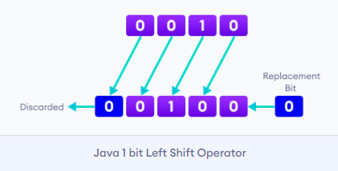
Left Shift Operator
Left shift operator shifts all bits towards the left by a certain number of specified bits.
It is denoted by <<.

Slide 91
Java Left Shift Operator Example
class OperatorExample{
public static void main(String args[]){
System.out.println(10<<2); //10*2^2=10*4=40
System.out.println(10<<3); //10*2^3=10*8=80
System.out.println(20<<2); //20*2^2=20*4=80
System.out.println(15<<4); //15*2^4=15*16=240
}}

Slide 92
Right Shift Operator
Right shift operator shifts all bits towards the right by a certain number of specified bits.
It is denoted by >>.
When we shift any number to the right, the least significant bits (rightmost) are discarded and the most significant position (leftmost) is filled with the sign bit.

Slide 93
Java Right Shift Operator Example
class OperatorExample{
public static void main(String args[]){
System.out.println(10>>2); //10/2^2=10/4=2
System.out.println(20>>2); //20/2^2=20/4=5
System.out.println(20>>3); //20/2^3=20/8=2
}}

Slide 94
Relation operators

Slide 95
Relation operators
Used to test comparison between operands or values.
Can be use to test whether two values are equal or not equal or less than or greater than etc.
Returns the Boolean results, i.e. true or false after the comparison

Slide 96
Operator | Description
== | Check if two operand are equal
!= | Check if two operand are not equal.
> | Check if operand on the left is greater than operand on the right
< | Check operand on the left is smaller than right operand
>= | check left operand is greater than or equal to right operand
<= | Check if operand on left is smaller than or equal to right operand

Slide 97
Example
int a, b;
a=40;
b=30;
System.out.println("a == b = " + (a == b) );
System.out.println("a != b = " + (a != b) );
System.out.println("a > b = " + (a > b) );
System.out.println("a < b = " + (a < b) );
System.out.println("b >= a = " + (b >= a) );
System.out.println("b <= a = " + (b <= a) );

Slide 98
Bitwise operators

Slide 99
Bitwise operators
Bitwise operators are used to perform operations bit by bit.
Java defines several bitwise operators that can be applied to the integer types long, int, short, char and byte.

Slide 100
Operator | Description
& | Bitwise AND
| | Bitwise OR
^ | Bitwise exclusive OR
<< | left shift
>> | right shift

Slide 101
truth table for bitwise &, | and ^
a | b | a & b | a | b | a ^ b
0 | 0 | 0 | 0 | 0
0 | 1 | 0 | 1 | 1
1 | 0 | 0 | 1 | 1
1 | 1 | 1 | 1 | 0

Slide 102
Bitwise OR Operator
12 = 00001100 (In Binary)
25 = 00011001 (In Binary)
Bitwise OR Operation of 12 and 25
00001100
| 00011001
____________
00011101 = 29 (In Decimal)

Slide 103
Program 1
class Main {
public static void main(String[] args) {
int number1 = 12, number2 = 25, result;
result = number1 | number2;
System.out.println(result); // prints 29
}
}

Slide 104
Bitwise AND Operator
12 = 00001100 (In Binary)
25 = 00011001 (In Binary)
// Bitwise AND Operation of 12 and 25
00001100
& 00011001
____________
00001000 = 8 (In Decimal)

Slide 105
Program
class Main {
public static void main(String[] args) {
int number1 = 12, number2 = 25, result;
// bitwise AND between 12 and 25
result = number1 & number2;
System.out.println(result); // prints 8
}
}

Slide 106
Bitwise XOR Operator
12 = 00001100 (In Binary)
25 = 00011001 (In Binary)
// Bitwise XOR Operation of 12 and 25
00001100
^ 00011001
____________
00010101 = 21 (In Decimal)

Slide 107
Program
class Main {
public static void main(String[] args) {
int number1 = 12, number2 = 25, result;
// bitwise XOR between 12 and 25
result = number1 ^ number2;
System.out.println(result); // prints 21
}
}

Slide 108
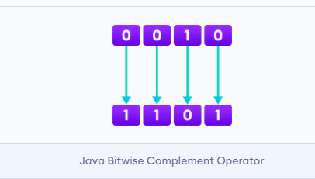
Bitwise Complement Operator
Bitwise complement operator is a unary operator (works with only one operand).
It is denoted by ~.
It changes binary digits 1 to 0 and 0 to 1.

Slide 109
The bitwise complement of any integer N is equal to - (N + 1).
For example,
Consider an integer 35.
As per the rule, the bitwise complement of 35 should be -(35 + 1) = -36.

Slide 110
Program
class Main {
public static void main(String[] args) {
int number = 35, result;
// bitwise complement of 35
result = ~number;
System.out.println(result); // prints -36
}
}

Slide 111
Logical Operators

Slide 112
Logical operators
Logical operators are used to check whether an expression is true or false.
They are used in decision making.

Slide 113
Operator | Example | Meaning
&& (Logical AND) | expression1 && expression2 | true only if both expression1 and expression2 are true
|| (Logical OR) | expression1 || expression2 | true if either expression1 or expression2 is true
! (Logical NOT) | !expression | true if expression is false and vice versa

Slide 114
class Main {
public static void main(String[] args) {
// && operator
System.out.println((5 > 3) && (8 > 5)); // true
System.out.println((5 > 3) && (8 < 5)); // false
// || operator
System.out.println((5 < 3) || (8 > 5)); // true
System.out.println((5 > 3) || (8 < 5)); // true
System.out.println((5 < 3) || (8 < 5)); // false
// ! operator
System.out.println(!(5 == 3)); // true
System.out.println(!(5 > 3)); // false
}
}

Slide 115
Java Ternary Operator
The ternary operator (conditional operator) is shorthand for the if-then-else statement.
variable = Expression ? expression1 : expression2
If the Expression is true, expression1 is assigned to the variable.
If the Expression is false, expression2 is assigned to the variable.

Slide 116
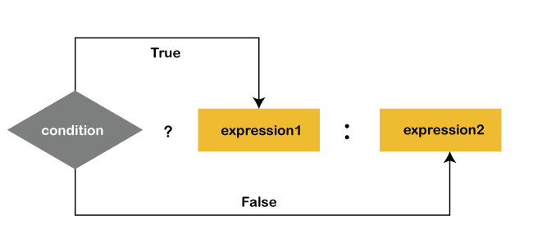

Slide 117
Example
int time = 20;
String result = (time < 18) ? "Good day." : "Good evening.";
System.out.println(result);

